Slide 1
HTML5 and CSS3
More on Images

Slide 2
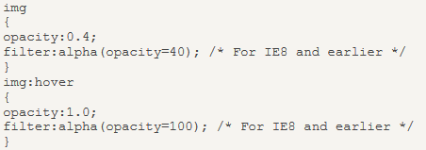
Image Transparency - Hover Effect
The first CSS block is similar to the code from semester 1.
We have added what should happen when a user hovers over one of the images.
In this case we want the image to NOT be transparent when the user hover over it.
When the mouse pointer moves away from the image, the image will be transparent again.

Slide 3
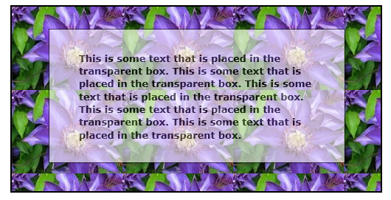
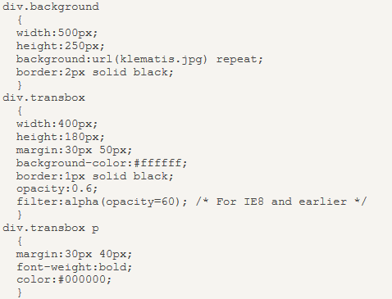
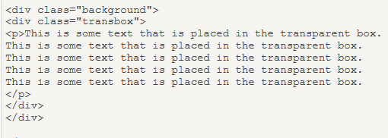
Text in Transparent Box

Slide 4
Text in Transparent Box
Create a div element (class="background") with a fixed height and width, a background image, and a border.
Create a smaller div (class="transbox") inside the first div element. The "transbox" div has a fixed width, a background color, a border and it is transparent.
Inside the transparent div, we add some text inside a p element.

Slide 5

CSS background-attachment Property
The background-attachment property sets whether a background image is fixed or scrolls with the rest of the page.
Value | Description
scroll | The background scrolls along with the element. This is default
fixed | The background is fixed with regard to the viewport
local | The background scrolls along with the element's contents

Slide 6
Other CSS3 background properties
CSS3 contains several new background properties, which allow greater control of the background element.
background-size
background-origin
background-clip
Internet Explorer 9+, Firefox, Chrome, Safari, and Opera support the new background properties.

Slide 7
background-size property
Specifies the size of the background image.
Before CSS3, the background image size was determined by the actual size of the image.
In CSS3 it is possible to specify the size of the background image, which allows us to re-use background images in different contexts.
You can specify the size in pixels or in percentages. If you specify the size as a percentage, the size is relative to the width and height of the parent element.
Note: when percentages are used, these relate to the width/height of the ‘background positioning area’ of the containing element (i.e. the space available for the background), not the width/height of the background image itself.

Slide 8
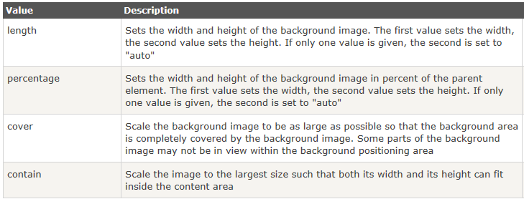

background-size property

Slide 9

background-size property
If declaring the background image size in pixels, be careful to avoid the image distorting; define either the width or the height, not both, and set the other value to auto.
This will preserve the aspect ratio of your image. If you only include one value, the second value is assumed to be auto.

Slide 10
background-size property
The default size of a background image is the actual size of the image. Sometimes the image is just a bit smaller or larger than its container.
You can define the size of your background image in pixels or percentages, or you can use the contain or cover key terms.
The contain value scales the image while preserving its aspect ratio; this may leave uncovered space.
The cover value scales the image so that it completely covers the element. This can result in clipping the image if the element and its background image have different aspect ratios.
http://www.css3.info/preview/background-size/

Slide 11
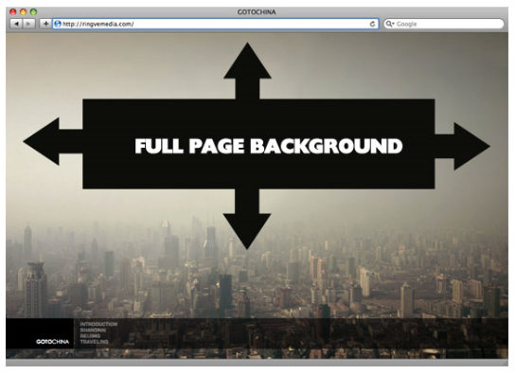
background image that covers the entire browser window
The goal here is a background image on a website that covers the entire browser window at all times.
Fills entire page with image, no white space
Scales image as needed
Retains image proportions (aspect ratio)
Image is centered on page
Does not cause scrollbars
As cross-browser compatible as possible
http://ringvemedia.com/

Slide 12
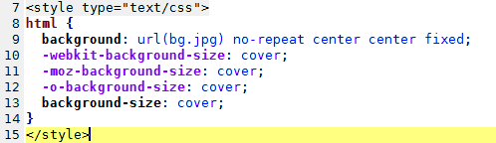
background image that covers the entire browser window
We'll use the html element (better than body as it's always at least the height of the browser window).
We set a fixed and centered background on it, then adjust it's size using background-size set to the cover keyword.

Slide 13
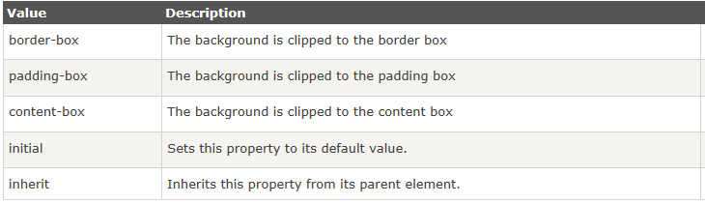
background-clip property
The background-clip property is used to determine whether the backgrounds extends into the border or not. The default is border-box, which means it DOES extend into it, but if you set it to padding-box so it doesn’t. if you use content-box the background only extends to the content area.
The background-clip property is supported in Internet Explorer 9+, Firefox, Opera, Chrome, and Safari.

Slide 14
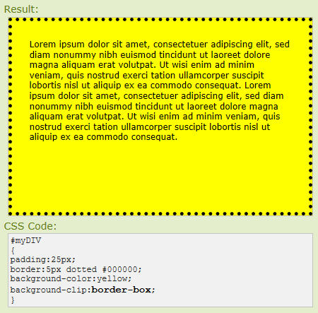
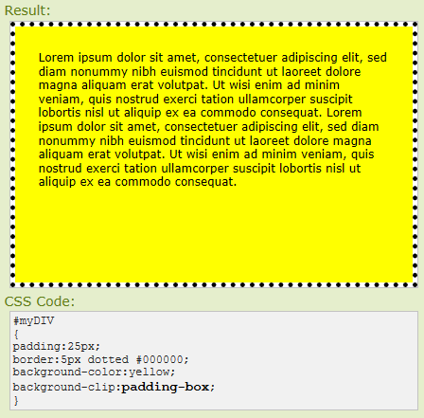

Slide 15
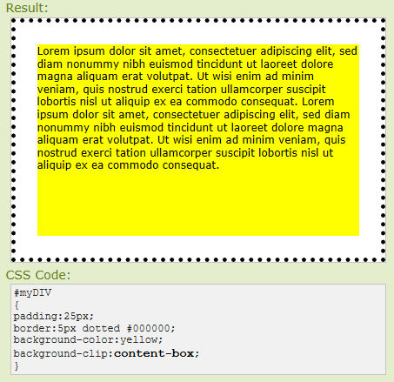
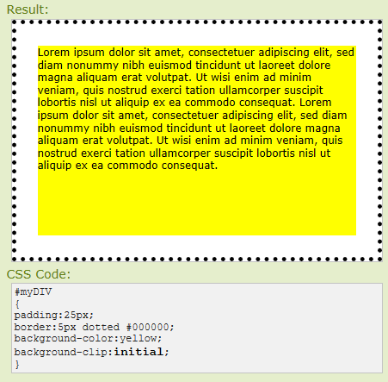

Slide 16
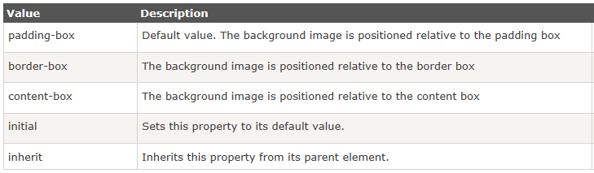
background-origin property
The background-origin property specifies what the background-position property should be relative to.
Note: If the background-attachment property for the background image is "fixed", this property has no effect.
The background-origin property is supported in IE9+, Firefox, Opera, Chrome, and Safari.

Slide 17
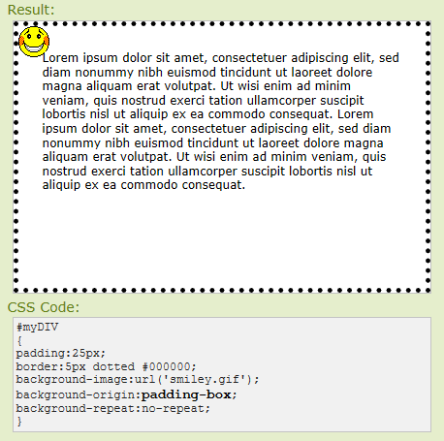
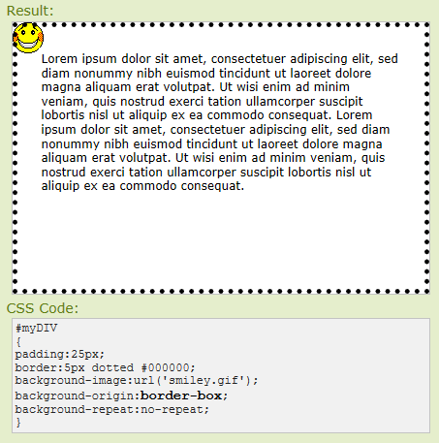

Slide 18
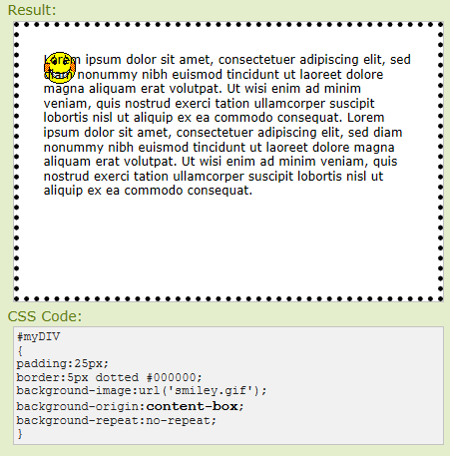
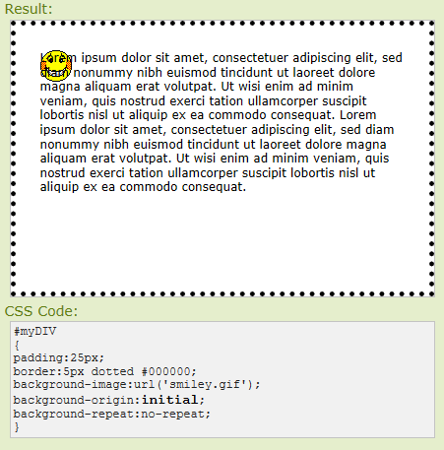

Slide 19

multiple background images
You can also set multiple background images for the document as shown.
Note: this site explains the difference between Positioning and Clipping Background Images - http://webdesign.about.com/od/css3tutorials/a/background-position-and-clipping.htm

